Slide 1
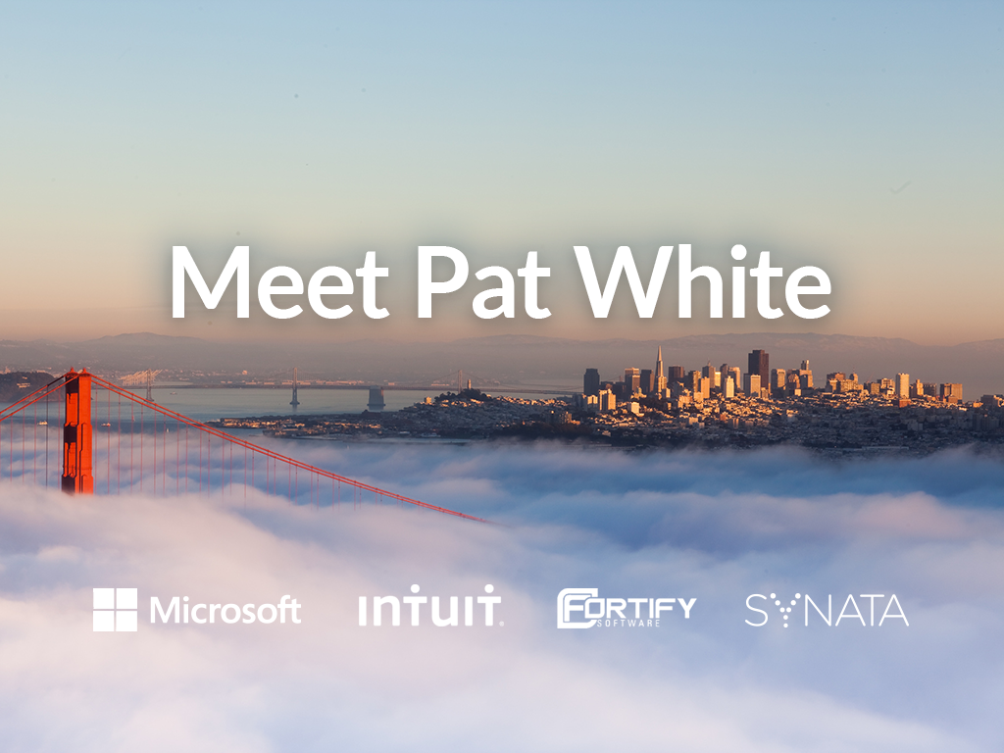

Slide 2

Agenda
Intro To Graphs
Overall Architecture
Setup Your Environment
GraphX Out of the Box
Implementing Your Own Algo’s

Slide 3
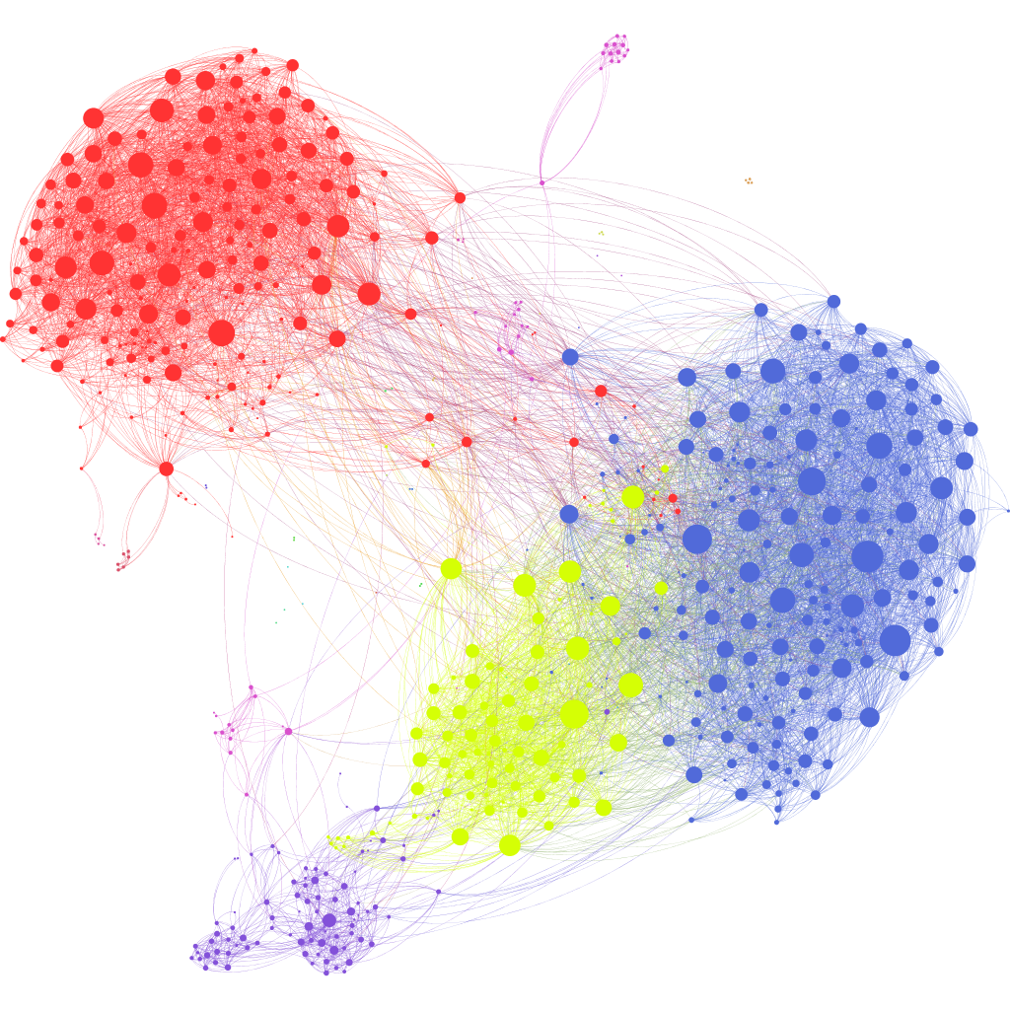



Intro to Graphs

Slide 4
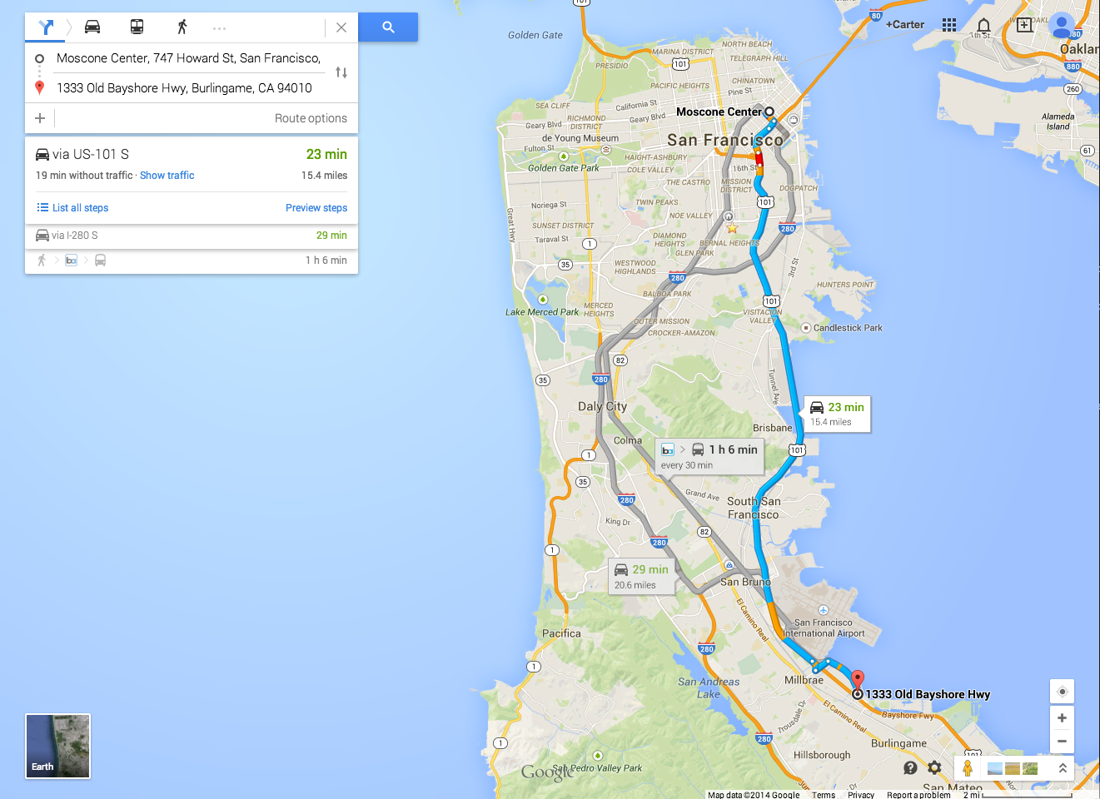
Networks are everywhere

Slide 5
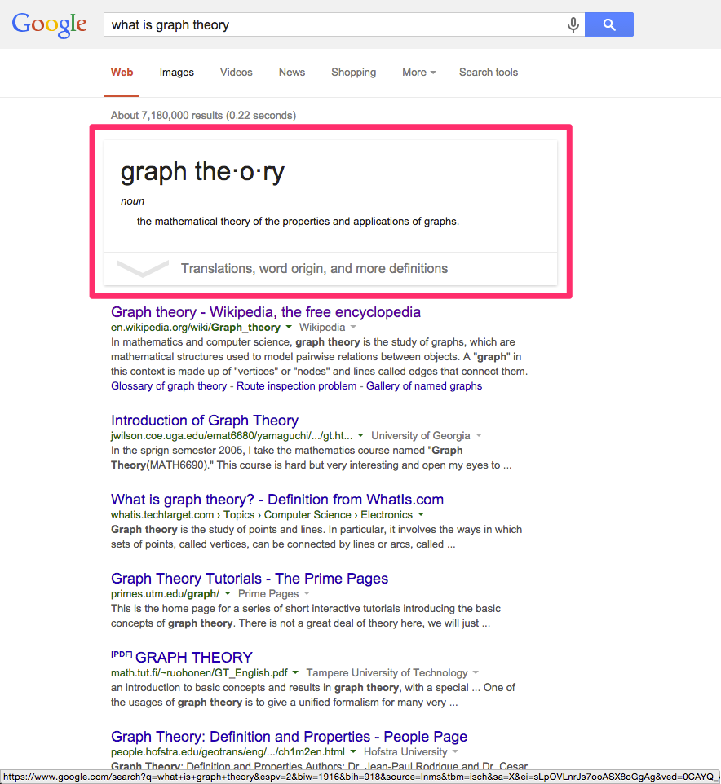
Notes:
Google’s Knowledge Graph

Slide 6
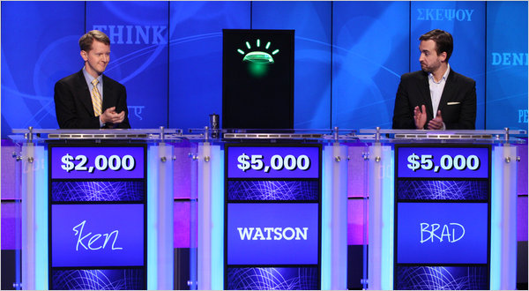
Watson v. Humans
Notes:
The Watson software is the cumulative bits of quite a few different systems, but several of the major components are graph analyses.

Slide 7

Impressed yet?

Slide 8
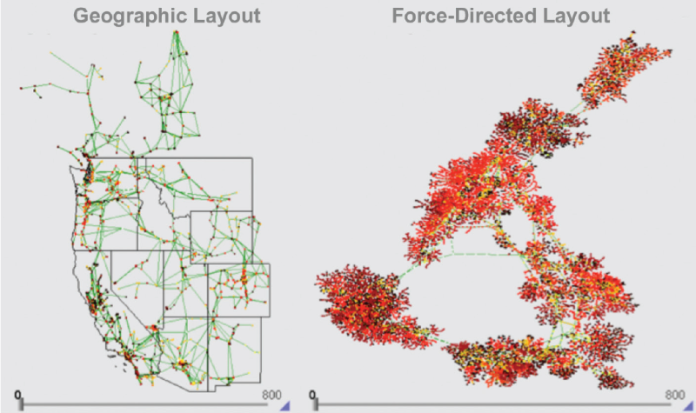
Western US Power Grid
Notes:
Researchers model the western US power grid as a graph to test resiliency in simulations of difference earthquake scenarios… But we’re here to talk about applications in enterprise settings, right?

Slide 9
Enterprise Data Graphs = $$$
Business intelligence – financial records, trading history, sales data
Recommendations – products, content, experts, ads
Fraud detection - customer analytics, enterprise IT
Logistics – order fulfillment, package delivery routing
Social – build, maintain, or detect communities
More…
Notes:
Without citing some bullshit figure from an analyst, just know that the applications of enterprise data graphs are worth more billions than you can count. Consider the impact the pagerank algorithm has had on the world – spawned one of the largest and most successful companies in history.

Slide 10
Graph Analysis 101
Model data as graphs to provide structure to disparate information
Analyze the structure to learn
You do not need a math PhD!
So, this guy named Euler…
Notes:
Pronounced “oiler”

Slide 11
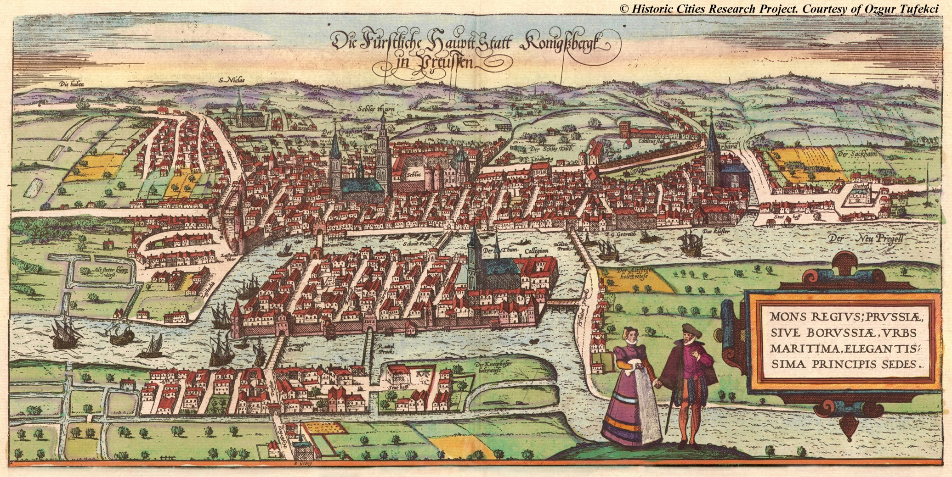
Bridges of Konigsberg
Notes:
Nearly every discipline in math has some classic examples problems guaranteed to be in every textbook ever printed on the subject. In Statistics, it’s the Monty Hall problem. In graph theory / topology, it’s the Bridges of Konigsberg. [pronounced koe-nigs-berg]
This guy, Leonhard Euler, was puzzled with a question in 1735 --- could you find a route through the city that would cross each bridge once and only once?

Slide 12
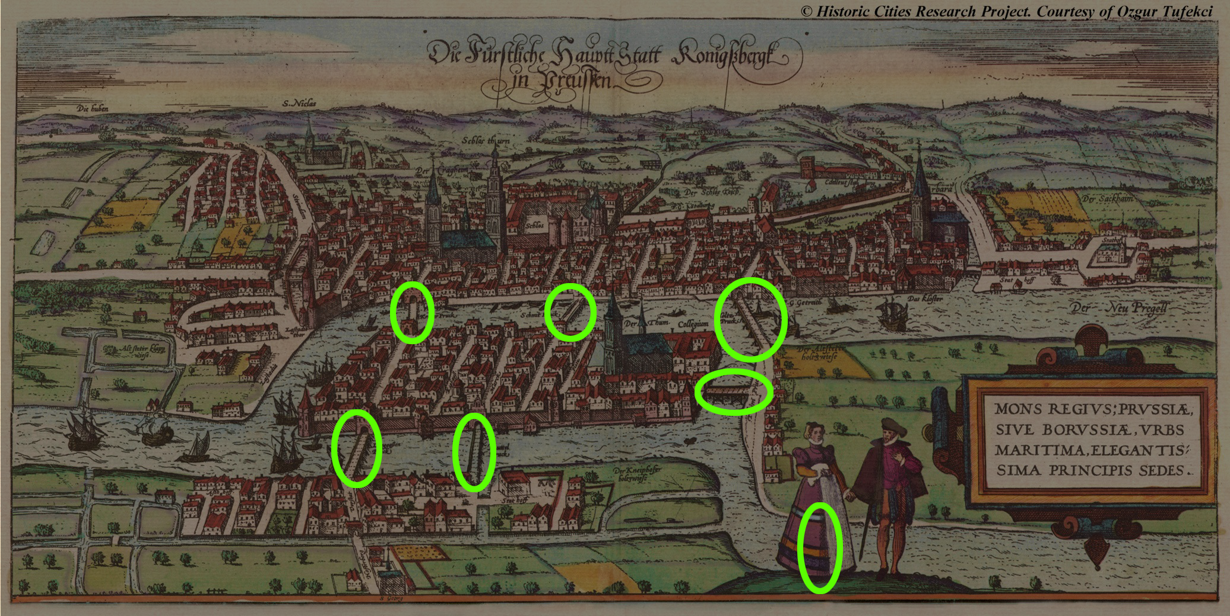
Bridges of Konigsberg

Slide 13
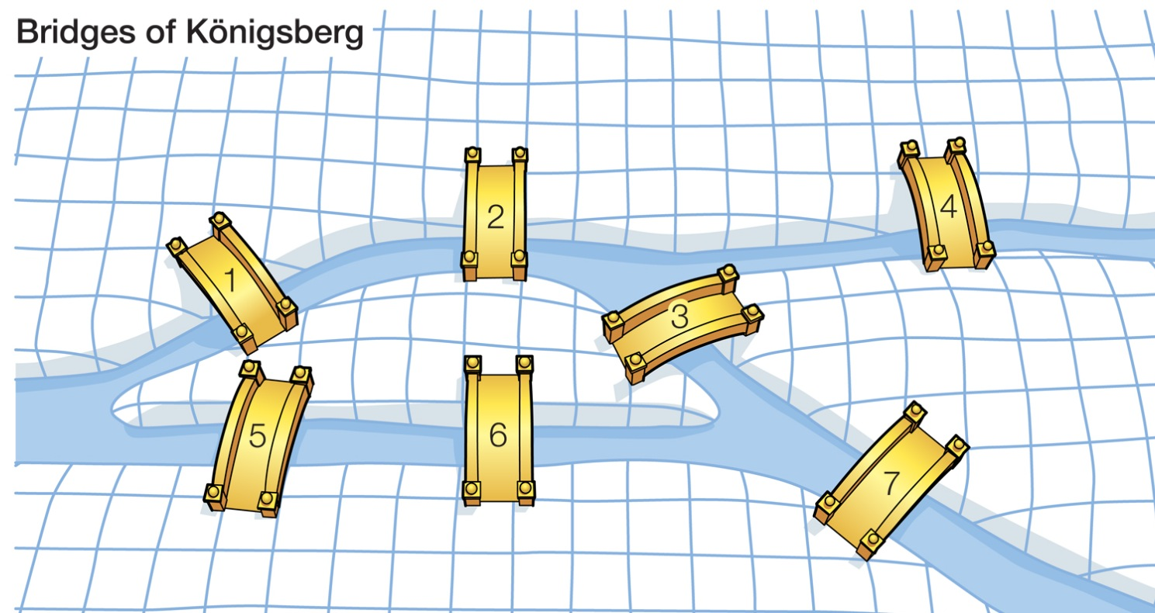
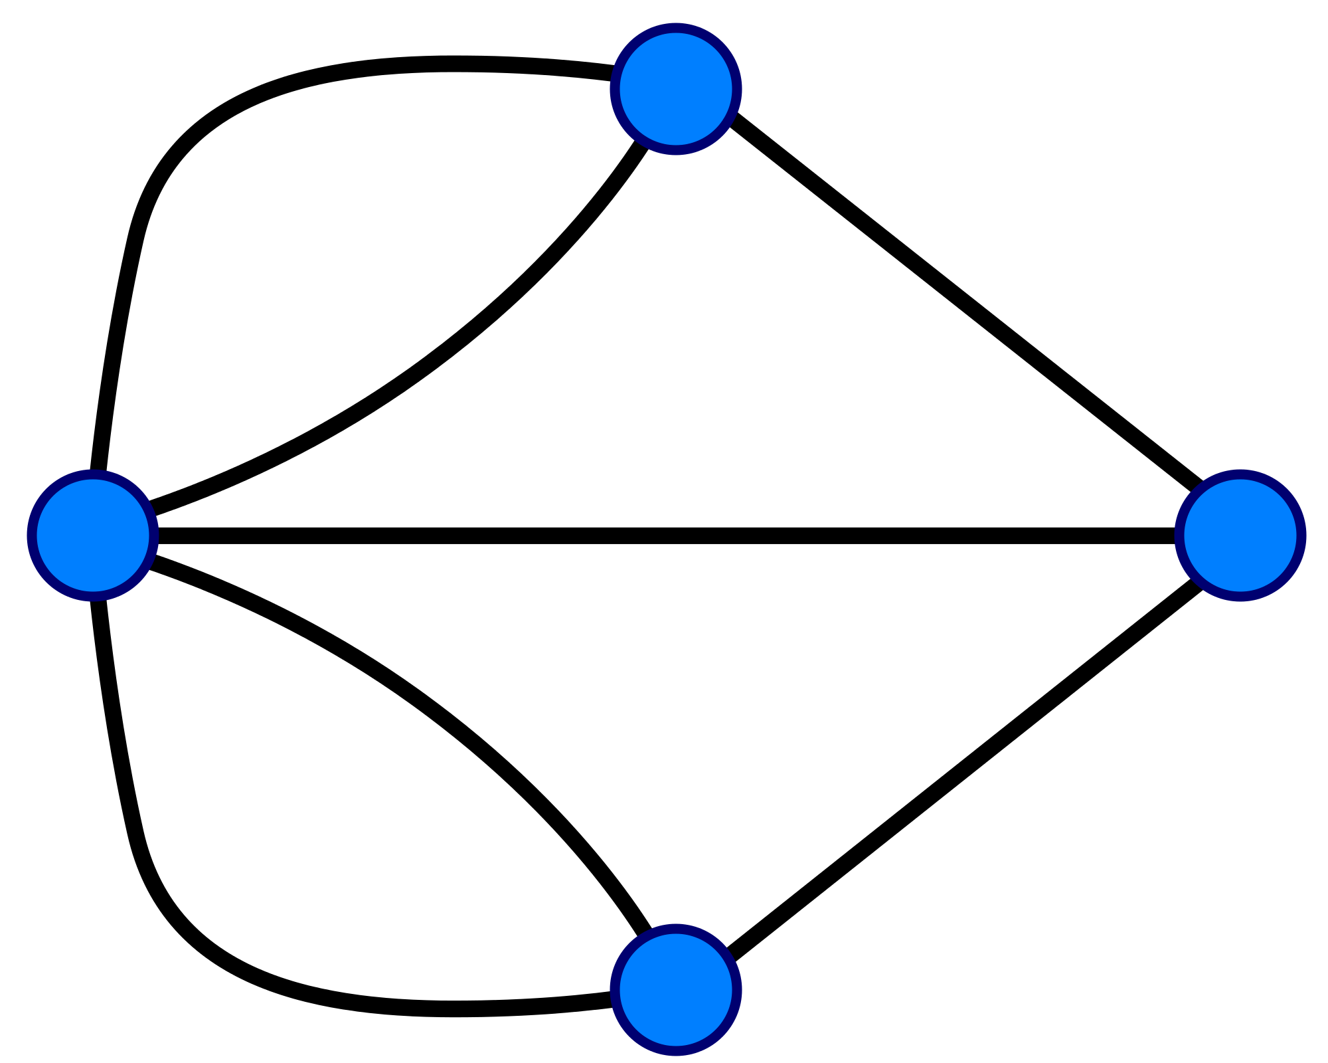
What is a graph?
Set of nodes and edges

Slide 14
Overall Architecture
Scala / Akka
Spark
Mongo

Slide 15
Getting Started
Typesafe Activator
Mongo
Sample Data
But, easier, just clone the repo:
https://github.com/Synata/SparkGraphAnalysis.git

Slide 16
Typesafe Activator
Optional, but Helpful
https://typesafe.com/platform/getstarted
Create a Scala Seed Project:
SparkGraphAnalysis

Slide 17
Setup Your Project 1
Download Spark
http://spark.apache.org/downloads.html
IMPORTANT: Pay attention to Hadoop Version…

Slide 18
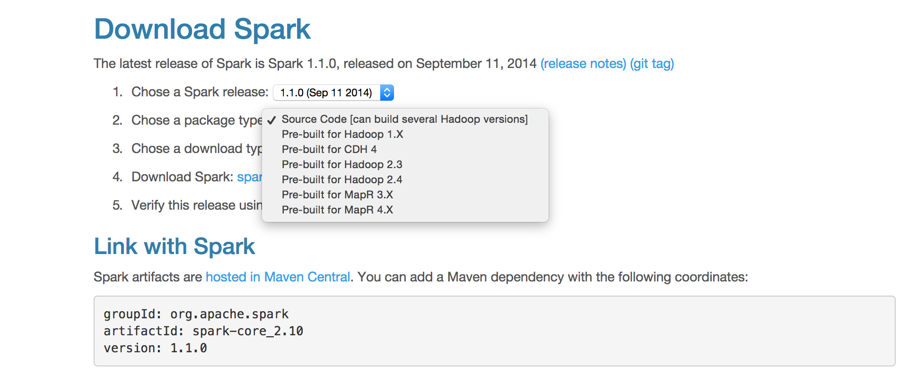
Download Spark

Slide 19
Setup Your Project 2
Download Mongo Java Driver
http://docs.mongodb.org/ecosystem/drivers/java/
And Mongo Hadoop Connector
https://github.com/mongodb/mongo-hadoop
IMPORTANT: Pay attention to Hadoop Version…
We want 2.4

Slide 20
All Files Go Into Lib
This is one of the Gotchas:
The Maven hosted versions don’t always have the correct Hadoop Version / Aren’t Consistent
So, Easier to Download and Manage Manually

Slide 21
SBT Assembly
Another Gotcha:
You need to create a single, distributable jar for Spark
SBT Assembly works well, but there are tricky parts

Slide 22
SBT Assembly (continued)
Create File project/plugins.sbt
Add Line:
addSbtPlugin("com.eed3si9n" % "sbt-assembly" % "0.11.2")

Slide 23
SBT Assembly (continued)
Create File assembly.sbt
Add:
import AssemblyKeys._
assemblySettings
test in assembly := {}
excludedJars in assembly <<= (fullClasspath in assembly) map { cp =>
cp.filter(m => {
m.data.getName == "spark-assembly-1.1.0-hadoop2.4.0.jar" ||
m.data.getName == "akka-remote_2.10-2.2.3-shaded-protobuf.jar" ||
m.data.getName == "akka-actor_2.10-2.2.3-shaded-protobuf.jar"
})
}

Slide 24
Load Your Sample Data
Google for “Gmail Rest API Playgroud”
Click “Authorize Oauth”
From the request, grab your token:
Authorization: Bearer <Your Token>

Slide 25
Load Your Sample Data
Run:
sbt “run load <Your Token>”

Slide 26
Working with Graphs
3 Things:
Storing Graphs
Querying Graphs
Analyzing Graphs

Slide 27

Let’s Get Coding

Slide 28
Update Build.sbt
Change Name
Change Scala Version
Important: Watch Your Versions!

Slide 29
Appendix – Graph Analysis
Where to learn about graph analysis
MOOCs:
Coursera – Social Network Analysis, Mining Massive Data Sets
Udacity – Introduction to Algorithms
Books:
Networks, Crowds, and Markets
Mining the Social Web, 2nd Edition
Introductory Graph Theory

Slide 30
Thanks!
Patrick White
pat.white@synata.com
@patwhite

